Slide 1
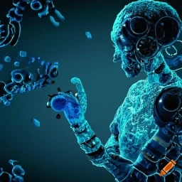
Machine Learning in Biology
BIO 4990/6990
January 17, 2024
Dr. Megan Smith
Mississippi State University
from craiyon

Slide 2


Mentimeter for PowerPoint

Slide 3


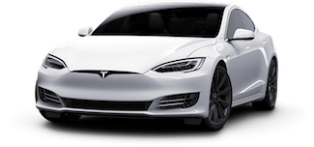





Slide 4

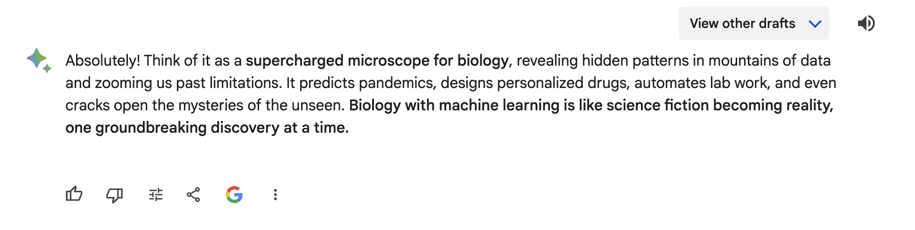
Should we use machine learning in Biology?

Slide 5
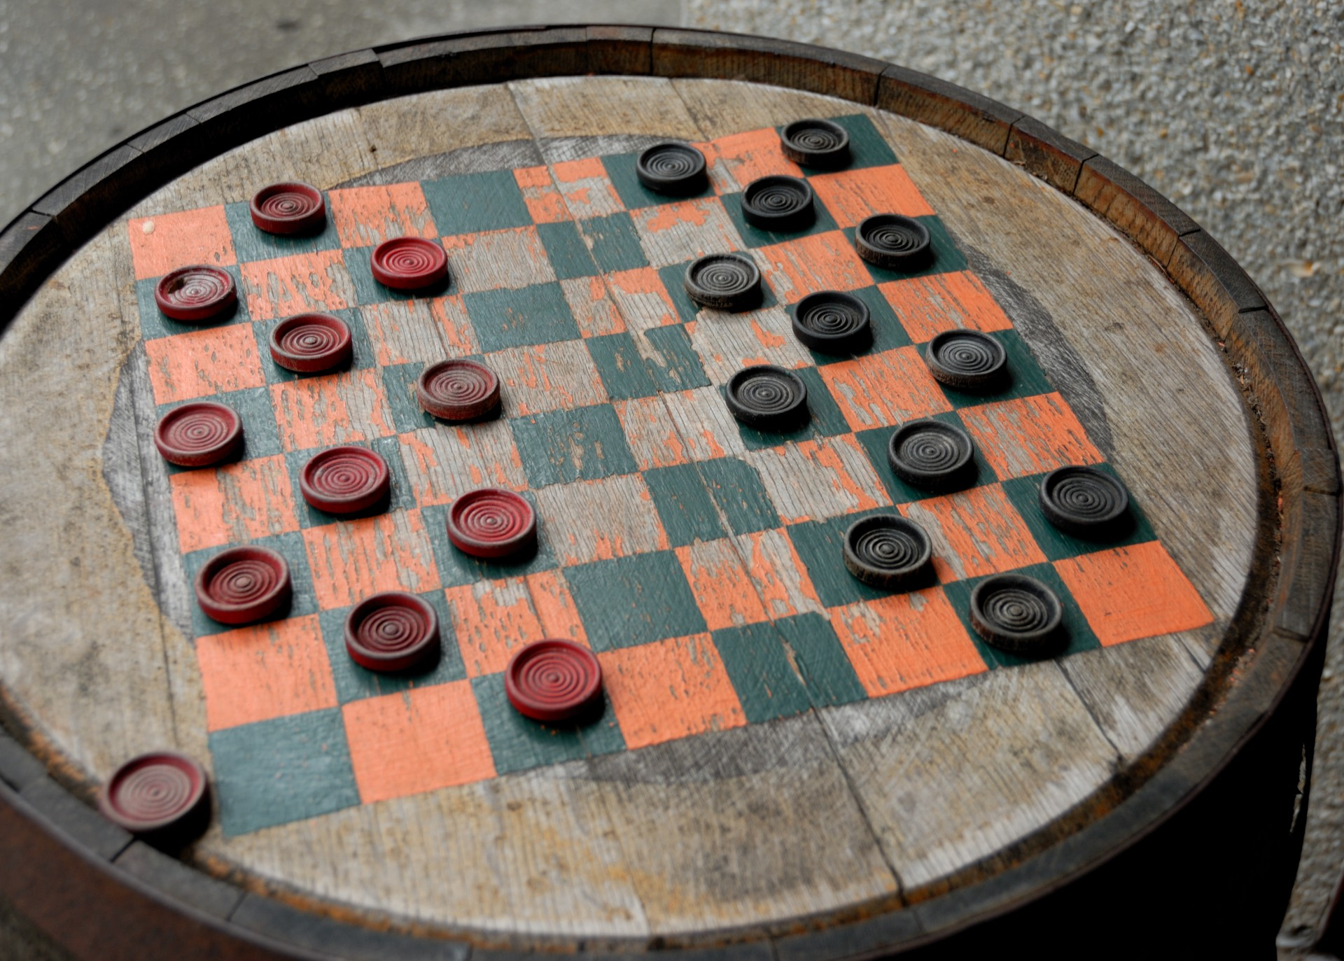
What is machine learning?
Machine Learning: ”the field of study that gives computers the ability to learn without explicitly being programmed.”
- Arthur Samuel (1959)

Slide 6
Types of machine learning
Supervised Learning
Unsupervised Learning

Slide 7
Supervised Learning
X
Y

Slide 8
Supervised Learning
X
Y
input
output

Slide 9
Supervised Learning
X
Y
input
output
features
labels

Slide 10
Supervised Learning
X
Y
input
output
features
labels
Learns the mapping from input features to output labels by being given data with known answers.

Slide 11
Supervised Learning
X
Y
input
output
features
labels
Learns the mapping from input features to output labels by being given data with known answers.

Slide 12
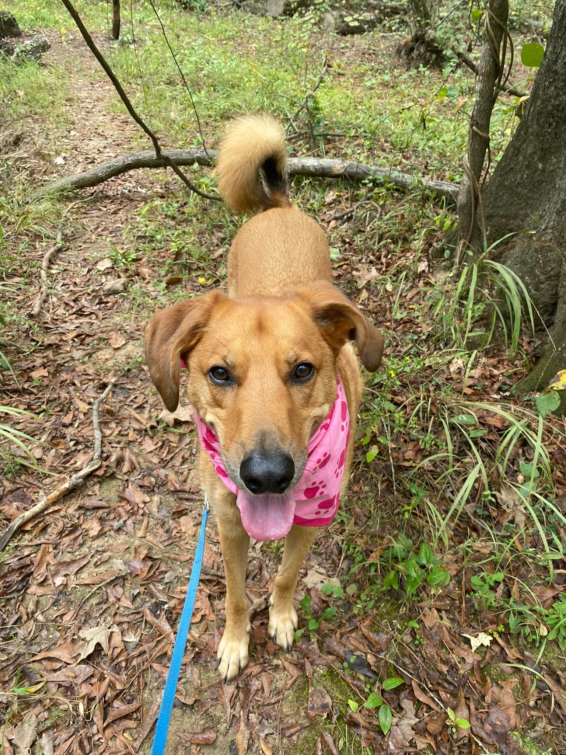
Supervised Learning
Goal: Predict whether there is a dog in an image

Slide 13
Supervised Learning
Goal: Predict whether there is a dog in an image
X: a set of images
Y: labels indicating whether or not there is a dog in each image

Slide 14
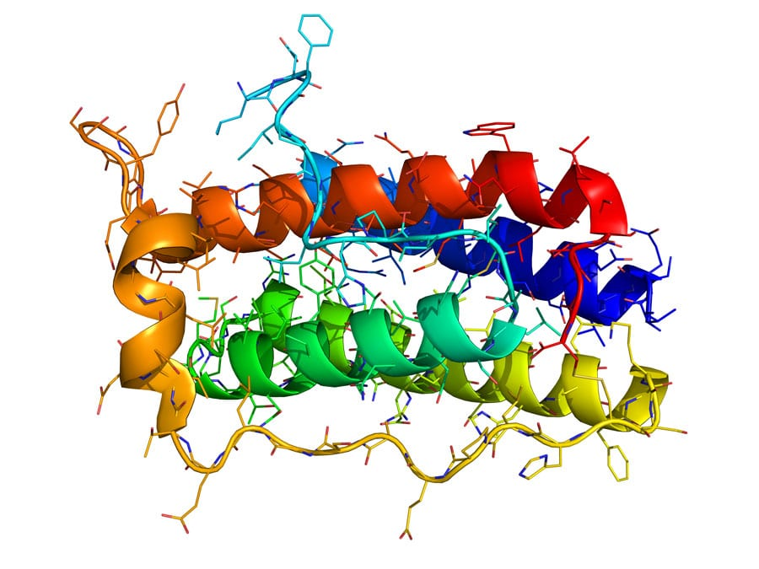
Supervised Learning
Goal: Predict the function of a protein

Slide 15
Supervised Learning
Goal: Predict the function of a protein
X: a set of protein sequences
Y: labels indicating the function of the proteins

Slide 16



Supervised Learning
Goal: Predict whether two populations of frogs exchange migrants

Slide 17
Supervised Learning
Goal: Predict whether two populations of frogs exchange migrants
X: a set of DNA sequences
Y: labels indicating whether the populations exchange migrants

Slide 18
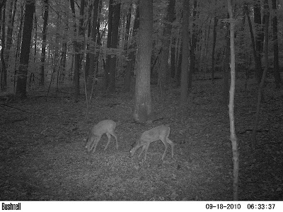
Supervised Learning
Goal: Predict whether there is a deer in an image from a trail camera
This Photo by Unknown Author is licensed under CC BY-NC-ND

Slide 19
Supervised Learning
Goal: Predict whether there is a deer in an image from a trail camera
X: a set of images
Y: labels indicating whether there is a deer in the image
This Photo by Unknown Author is licensed under CC BY-NC-ND

Slide 20
Regression: plant height prediction
40
35
39
25
Height
(cm)
20
15
10
5
2,000
4,000
6,000
8,000
10,000
Elevation (ft)

Slide 21
Regression: plant height prediction
40
35
39
25
Height
(cm)
20
15
10
5
2,000
4,000
6,000
8,000
10,000
Elevation (ft)

Slide 22
Regression: plant height prediction
40
35
39
25
Height
(cm)
20
15
10
5
2,000
4,000
6,000
8,000
10,000
Elevation (ft)

Slide 23
Regression: plant height prediction
40
35
39
25
Height
(cm)
20
15
10
5
2,000
4,000
6,000
8,000
10,000
Elevation (ft)

Slide 24
Regression: plant height prediction
40
35
39
25
Height
(cm)
20
15
10
5
2,000
4,000
6,000
8,000
10,000
Elevation (ft)

Slide 25
Regression: plant height prediction
Regression: predict a number (infinitely many possible outputs)
40
35
39
25
Height
(cm)
20
15
10
5
2,000
4,000
6,000
8,000
10,000
Elevation (ft)

Slide 26
Classification: plant species prediction

Slide 27
Classification: plant species prediction
setosa = 0
virginica = 1

Slide 28
Classification: plant species prediction
setosa = 0
virginica = 1

Slide 29
Classification: plant species prediction
Classification:
predict categories
(i.e., classes)

Slide 30
Classification: plant species prediction

Slide 31


Classification: plant species prediction

Slide 32
Types of machine learning
Supervised Learning
Uses labeled datasets to train algorithms to predict outcomes.
regression: predict a number (infinitely many possible outcomes)
classification: predict a category (fixed number of possible outputs).
Unsupervised Learning

Slide 33
Unsupervised Learning

Slide 34
Unsupervised Learning
Goal: Find patterns in unlabeled data.

Slide 35


Unsupervised Learning
Goal: Find patterns in unlabeled data.
Clustering

Slide 36
Unsupervised Learning
Data comes with inputs X, but not with output labels Y.
Algorithm finds structure in the data
Clustering
Group similar data points together.

Slide 37
Unsupervised Learning
Data comes with inputs X, but not with output labels Y.
Algorithm finds structure in the data
Clustering
Group similar data points together.
Dimensionality Reduction
Transform data from a high-dimensional space to a low-dimensional space such that the meaningful properties are retained.

Slide 38
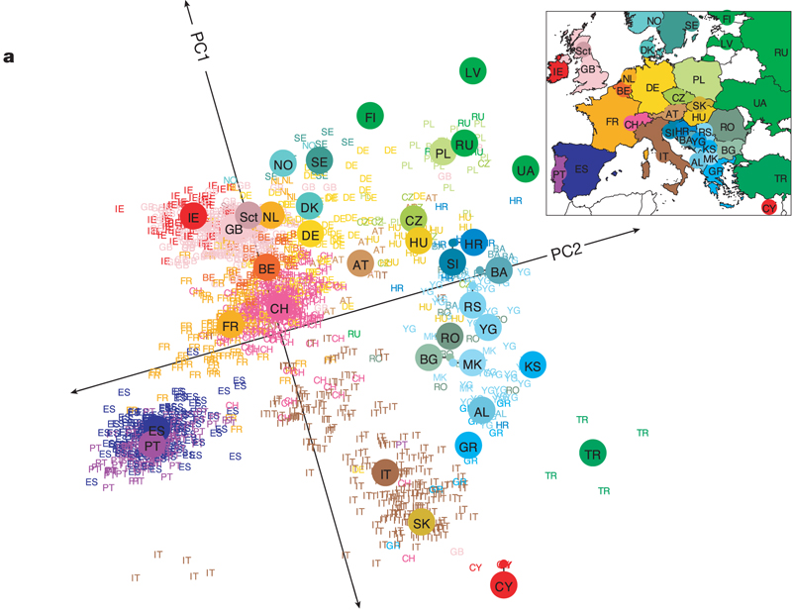
Unsupervised Learning
Novembre et al., Nature (2008)

Slide 39
Types of machine learning
Supervised Learning
Uses labeled datasets to train algorithms to predict outcomes.
regression: predict a number (infinitely many possible outcomes)
classification: predict a category (fixed number of possible outputs).
Unsupervised Learning
Uses algorithms to find patterns in unlabeled data.
clustering: find groups of observations
dimensionality reduction: project from high- to low-dimensional space

Slide 40

Mentimeter for PowerPoint

